Slide 1
Neural Network

Slide 2
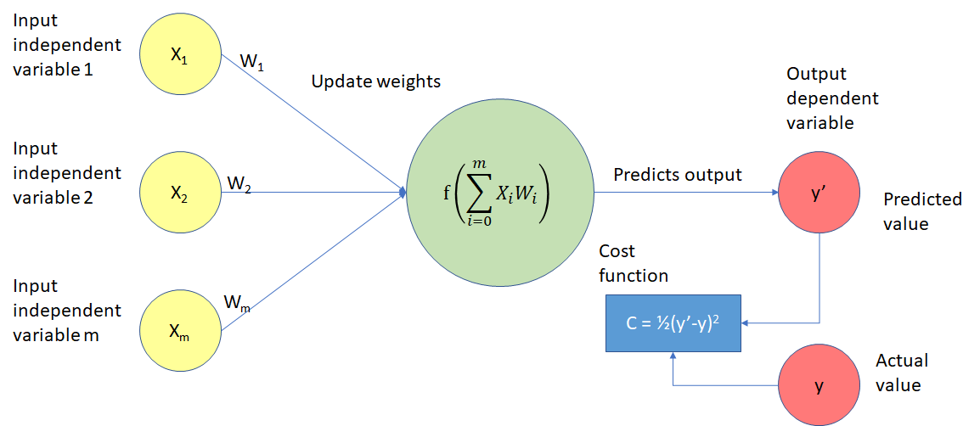
Working of Neural Network

Slide 3
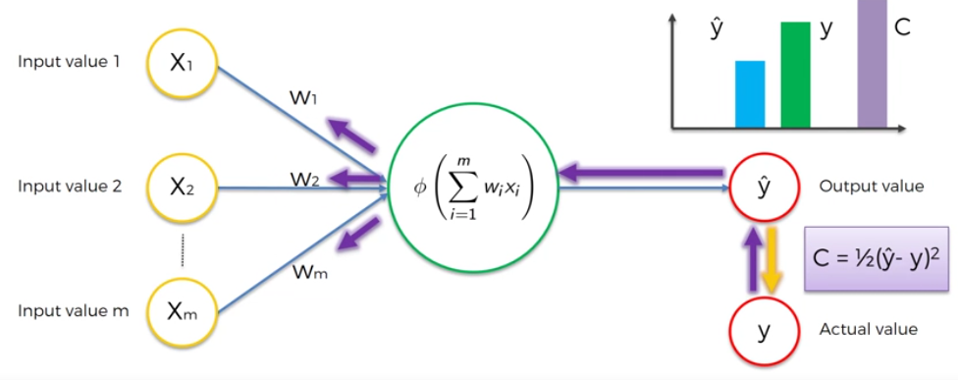

Slide 4
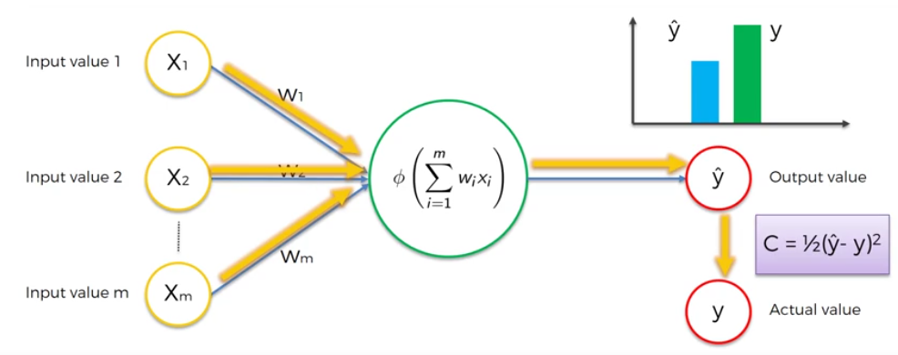

Slide 5
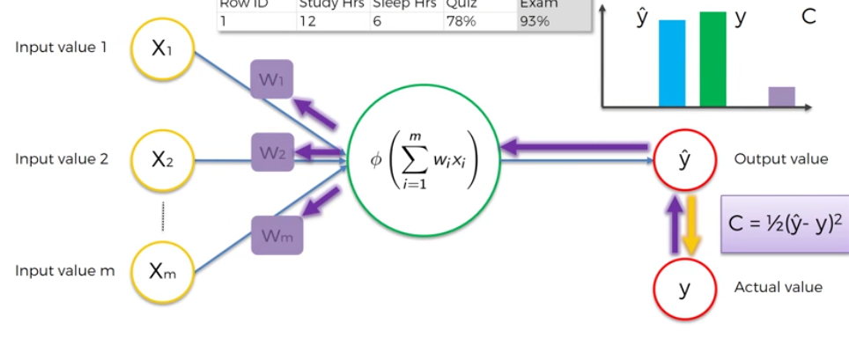
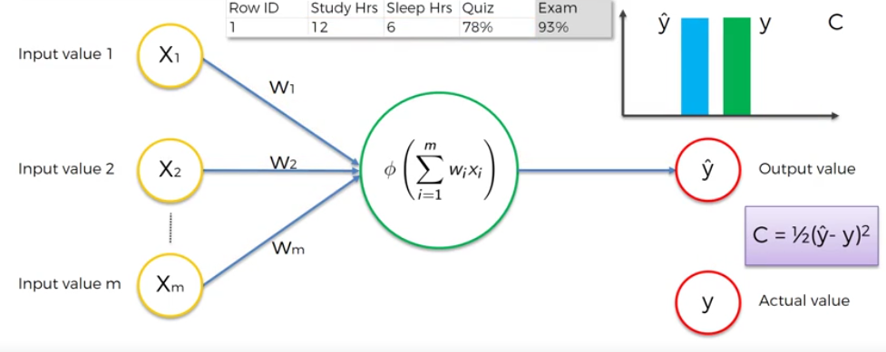

Slide 6
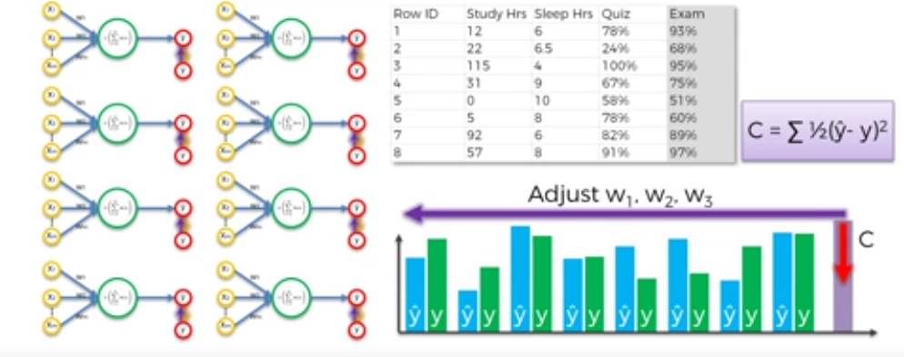

Slide 7
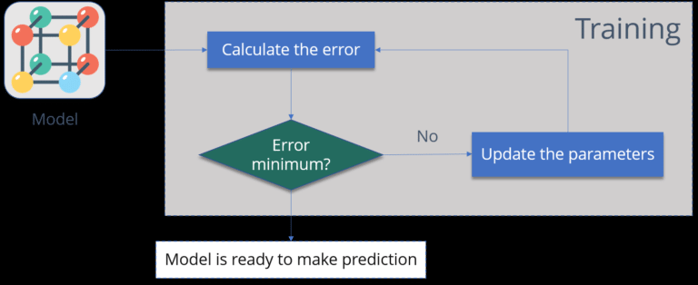
Backpropagation

Slide 8
Backpropagation
1.Calculate the error:
How far is your model output from the actual output.
2.Minimum Error:
Check whether the error is minimized or not.
3.Update the parameters:
If the error is huge then, update the parameters (weights and biases). After that again check the error. Repeat the process until the error becomes minimum.
4.Model is ready to make a prediction:
Once the error becomes minimum, you can feed some inputs to your model and it will produce the output.

Slide 9
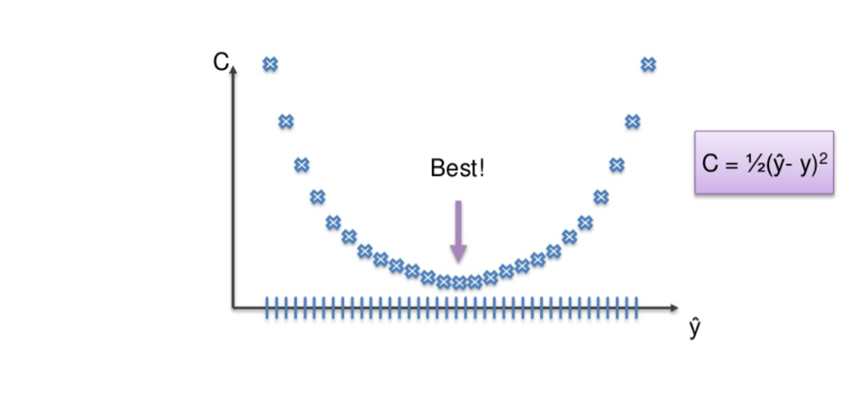
Two ways to adjust the weights
Brute-force approach:
This is far better suited to a single-layer feet-forward network.
We take a number of possible weights. On a graph it looks like this:

Slide 10
Brute-force approach:
We have to eliminate all other weights except for the one right at the bottom of the U-shape, the one closest to 0.
The closer to 0, the lower the difference between output value and actual value.
We could have an almost infinite amount of weights to adjust. Therefore a process of elimination would be like looking for the prettiest grain of sand on a beach.
This problem is known as the Curse of Dimensionality.

Slide 11
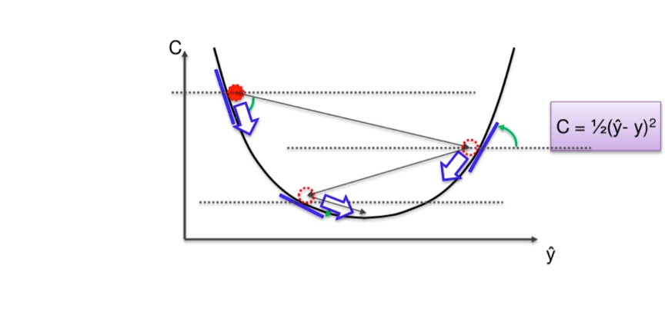
Gradient Descent
Instead of going through every weight one at a time, and ticking every wrong weight off as we go, we instead look at the angle of the cost function line.
If the slope is negative, like it is from the highest red dot on the above line, that means we must go downhill from there.
This eliminates a vast number of incorrect weights on the way down. It also reduces the time and effort spent on finding the right weight.

Slide 12
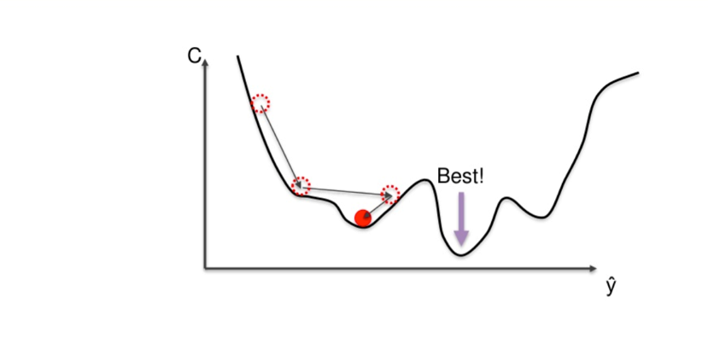
The Difference between Local and Global

Slide 13
Stochastic Gradient Descent
With the Gradient Descent method, all the weights for all ten rows of data are adjusted simultaneously.
Gradient Descent can take a little longer than the Stochastic method because with every adjustment, every piece of data has to be loaded up all over again.
With the Stochastic method, each weight is adjusted individually.
It also has much higher fluctuations, so on a non-convex graph it is more likely to find the global minimum rather than the local minimum.
The Stochastic method is a lighter algorithm and therefore faster than its all-encompassing cousin

